Slide 1


Ending Hunger: Your Impact Matters
Together, we can make a difference in the fight against hunger. We are dedicated to providing food and resources to those in need, ensuring no one goes hungry.
by Shashank

Slide 2
The Reality of Hunger
Over 828 million people worldwide experience hunger, lacking access to nutritious food.
This lack of access impacts children, families, and communities, causing malnutrition and health issues.

Slide 3

How Your Donation Makes a Difference
Food Security
Community Support
Empowerment
Provides access to nutritious meals, ensuring families have enough food to thrive.
Supports local food banks and pantries, empowering communities to address hunger.
Offers resources and opportunities to address the root causes of hunger, breaking the cycle.

Slide 4




Our Impact: Transforming Lives
Food Distribution
We have provided over 100,000 meals to those in need through our network of partners.
Community Support
We have partnered with local organizations to create sustainable food access programs.
Empowerment
We provide resources and training to help individuals overcome hunger and achieve self-sufficiency.

Slide 5

How You Can Help
Donate
Volunteer
Every dollar helps provide meals and support to those in need.
Get involved in your community by volunteering at local food banks.
Spread Awareness
Share our mission and encourage others to join the fight against hunger.

Slide 6
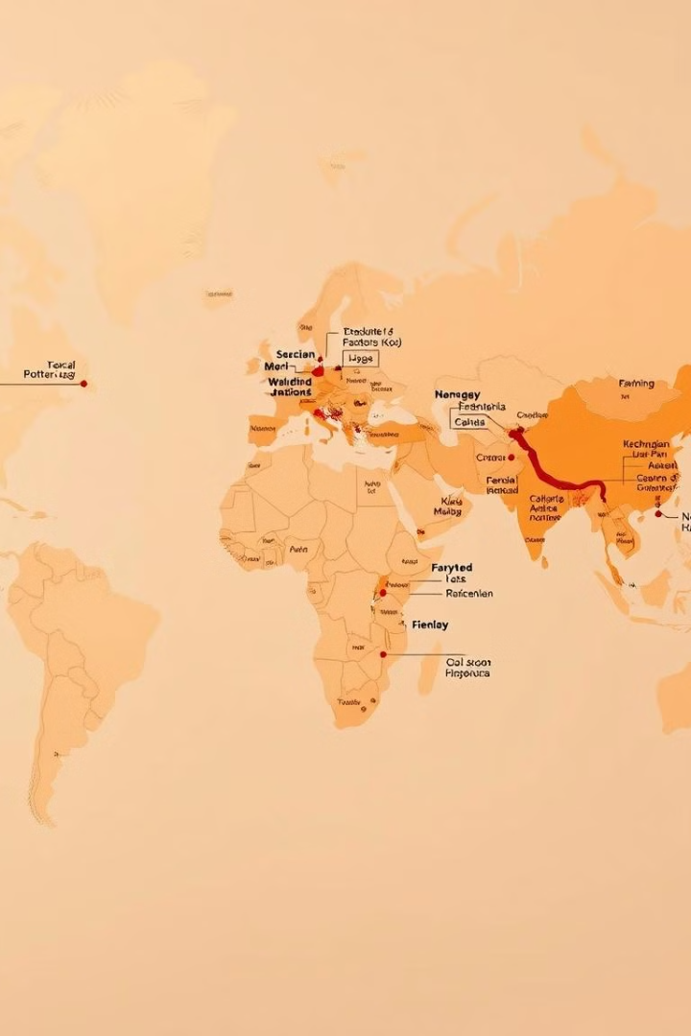
Together, We Can End Hunger
1
Your donation helps us provide food and resources to those in need.
2
We support local food banks and pantries, empowering communities to fight hunger.
3
We work to address the root causes of hunger, creating a lasting impact.

Slide 7



Join Our Mission
1
Food Security
2
Community Support
3
Empowerment

Slide 8

Make a Difference Today
Visit our website to learn more about our mission and how you can contribute. Together, we can make a lasting impact in the fight against hunger.

